Slide 1

Team Promotion Alarm Clock
Simple Habits

Slide 2

Agenda
Approach
Project Management
Technical
Architecture
Testing
Demo

Slide 3

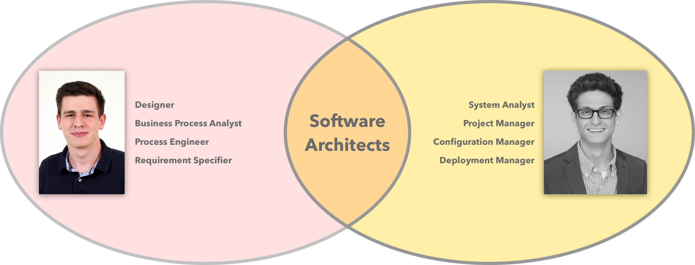
Team
Notes:
NUR 2!!!!!!
(worth the project)

Slide 4

Approach

Slide 5

Approach - Vision
Real – Time
Simple
Assistance
Reliable
Smart

Slide 6

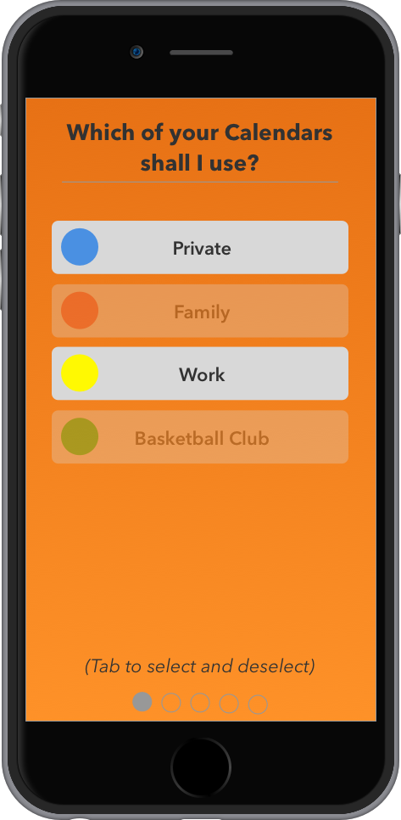
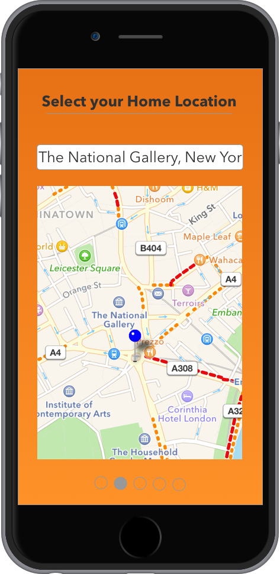
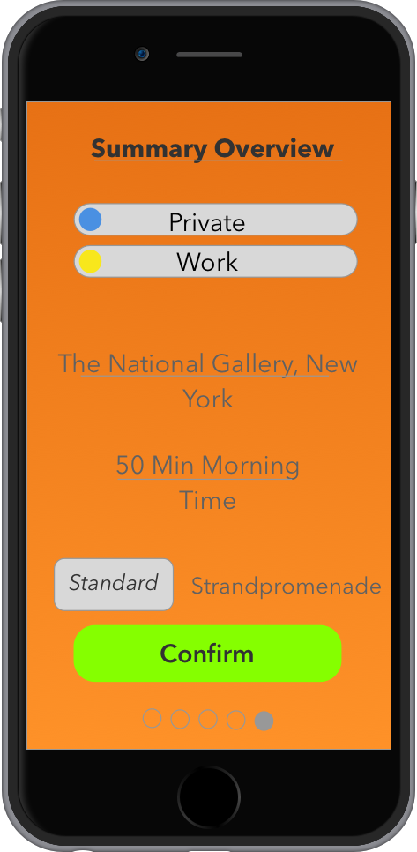
Approach – Mock Ups

Slide 7

Project Management

Slide 8
Project Management – Methodology
Why not Waterfall?

Slide 9
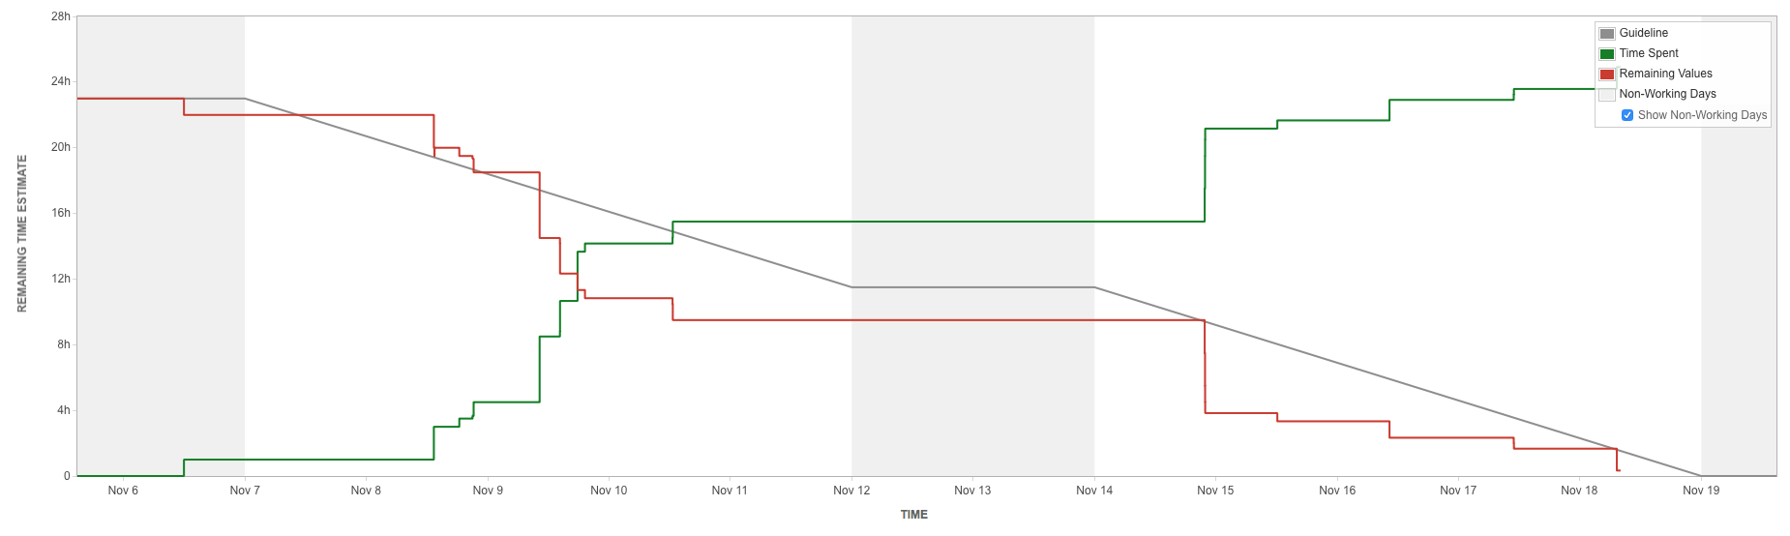
Project Management – Scrum Tool

Slide 10
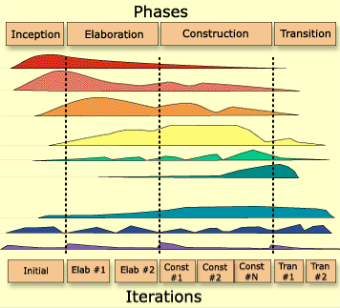
Project Management – Rational Unified Process
Long Term Planning
Disciplines
Business Modelling
Requirements
Analysis & Design
Implementation
Test
Deployment
Configuration &
Change Management
Environment
Project Management

Slide 11
Project Management – Risk Management
Notes:
Impact 0-10
Faktorberechnung durch Multiplikation

Slide 12
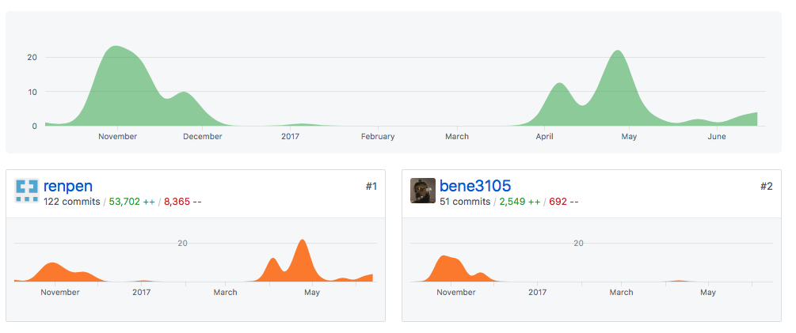

Project Management – Version Control
Notes:
Updaten

Slide 13
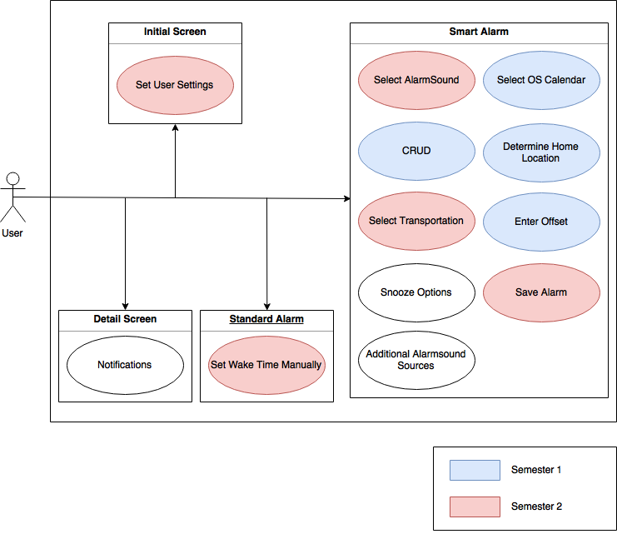
Project Management – Overall Use Case Diagram

Slide 14
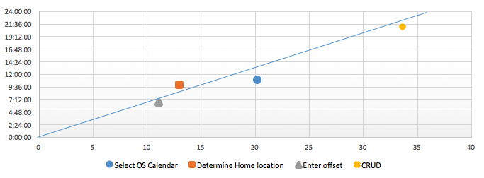

Project Management –Time Estimation
Based on Function Points Calculation

Slide 15

Technical Environment

Slide 16
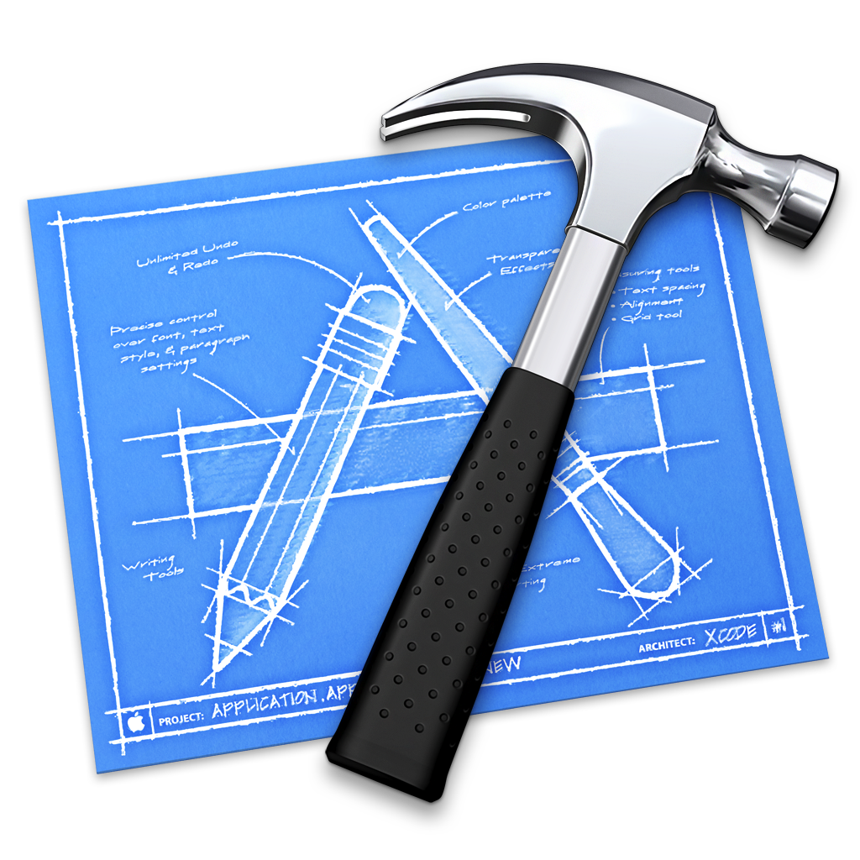

Technical Environment – iOS

Slide 17
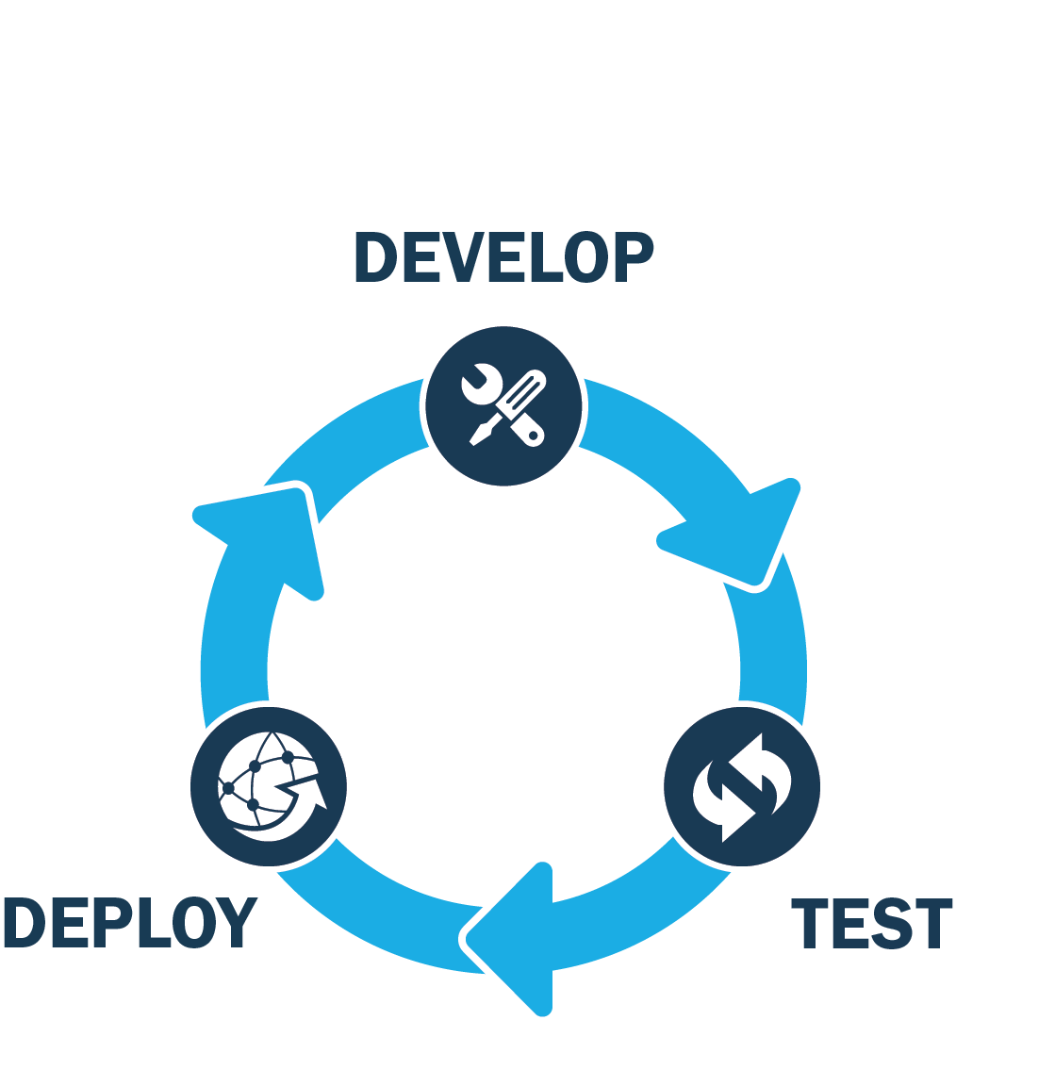

Technical Environment – Continuous Integration

Slide 18
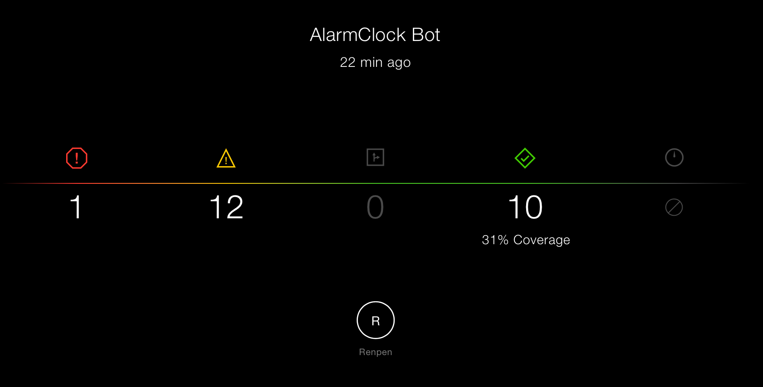
Technical Environment – CI Insights
Notes:
Automated testing

Slide 19
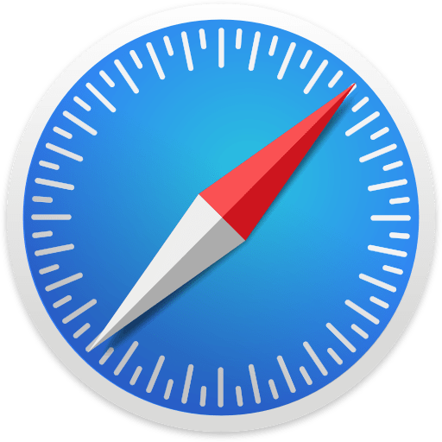
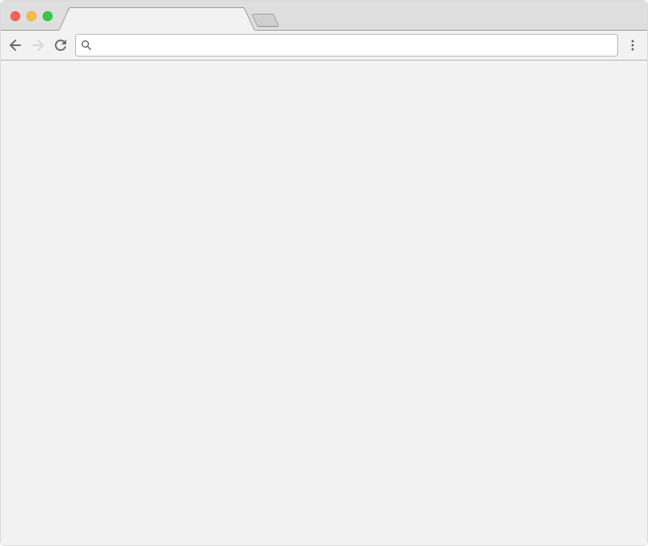
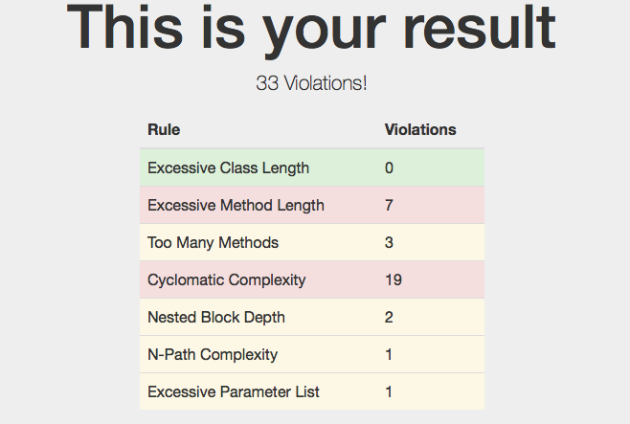
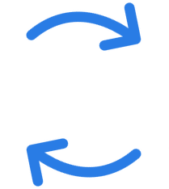

Technical Environment – Metrics
Browser
Parser
Metrics Measurement (Taylor)
Project code base

Slide 20

Architecture

Slide 21
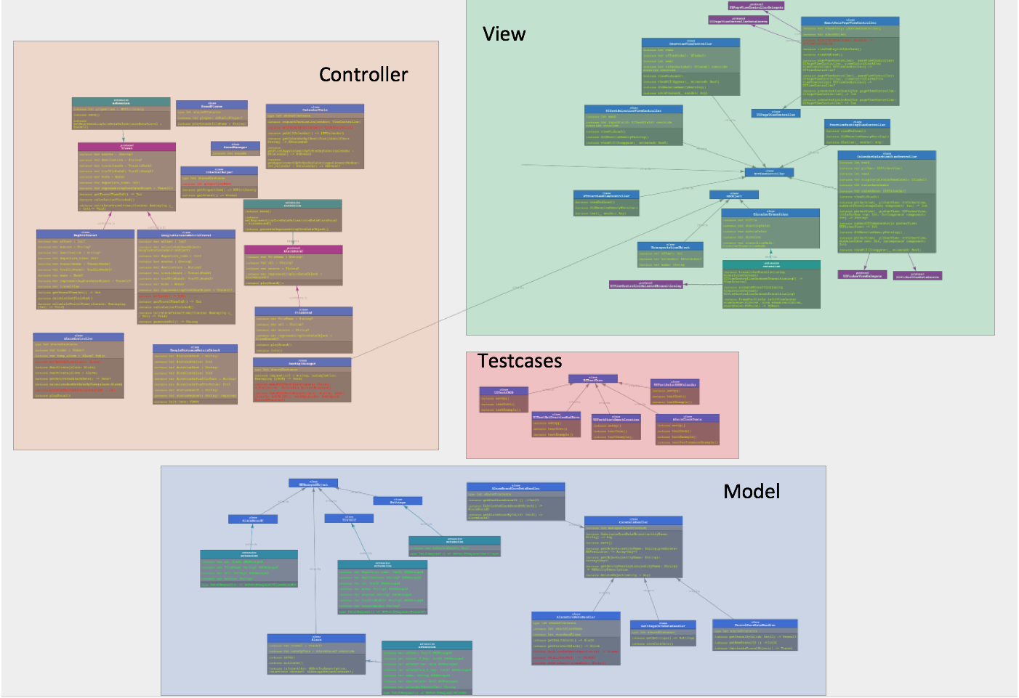
Architecture – Class Diagram
Notes:
Man sieht sehr komplex, einzelheiten zu viel für präsentation, aber nach mvc

Slide 22
Architecture – Patterns
Decorator
State
Visitor
Singleton
Factory
Observer
Iterator
Notes:
Warum patterns?

Slide 23
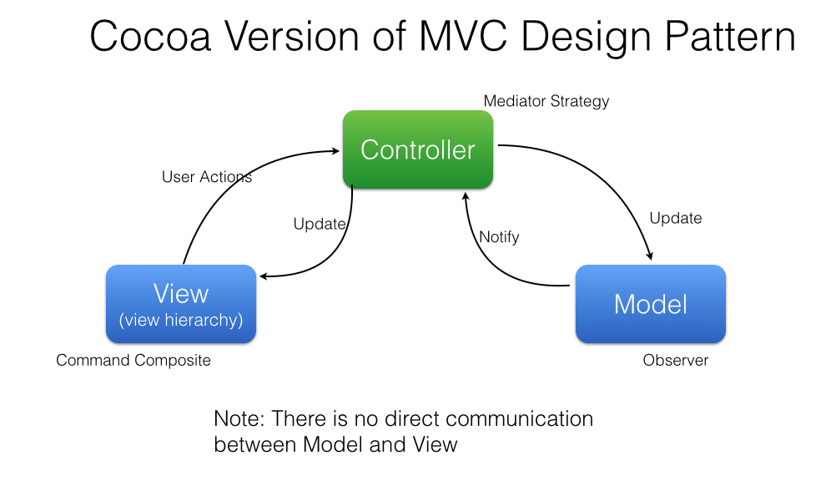
Architecture – MVC Pattern
In Context of Swift
Notes:
Warum patterns?

Slide 24
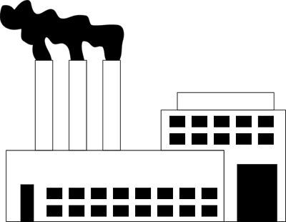

Architecture – Fabricate Pattern

Slide 25

Testing Infrastructure

Slide 26
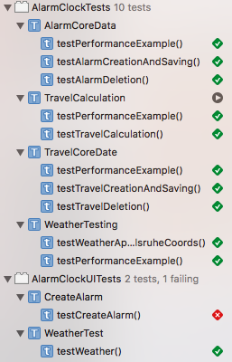
Testing Infrastructure – Xcode Unit- & UI-Testing
Notes:
IDE Support, UI and Unit,Test-Plan erwähnen

Slide 27

Demo

Slide 28
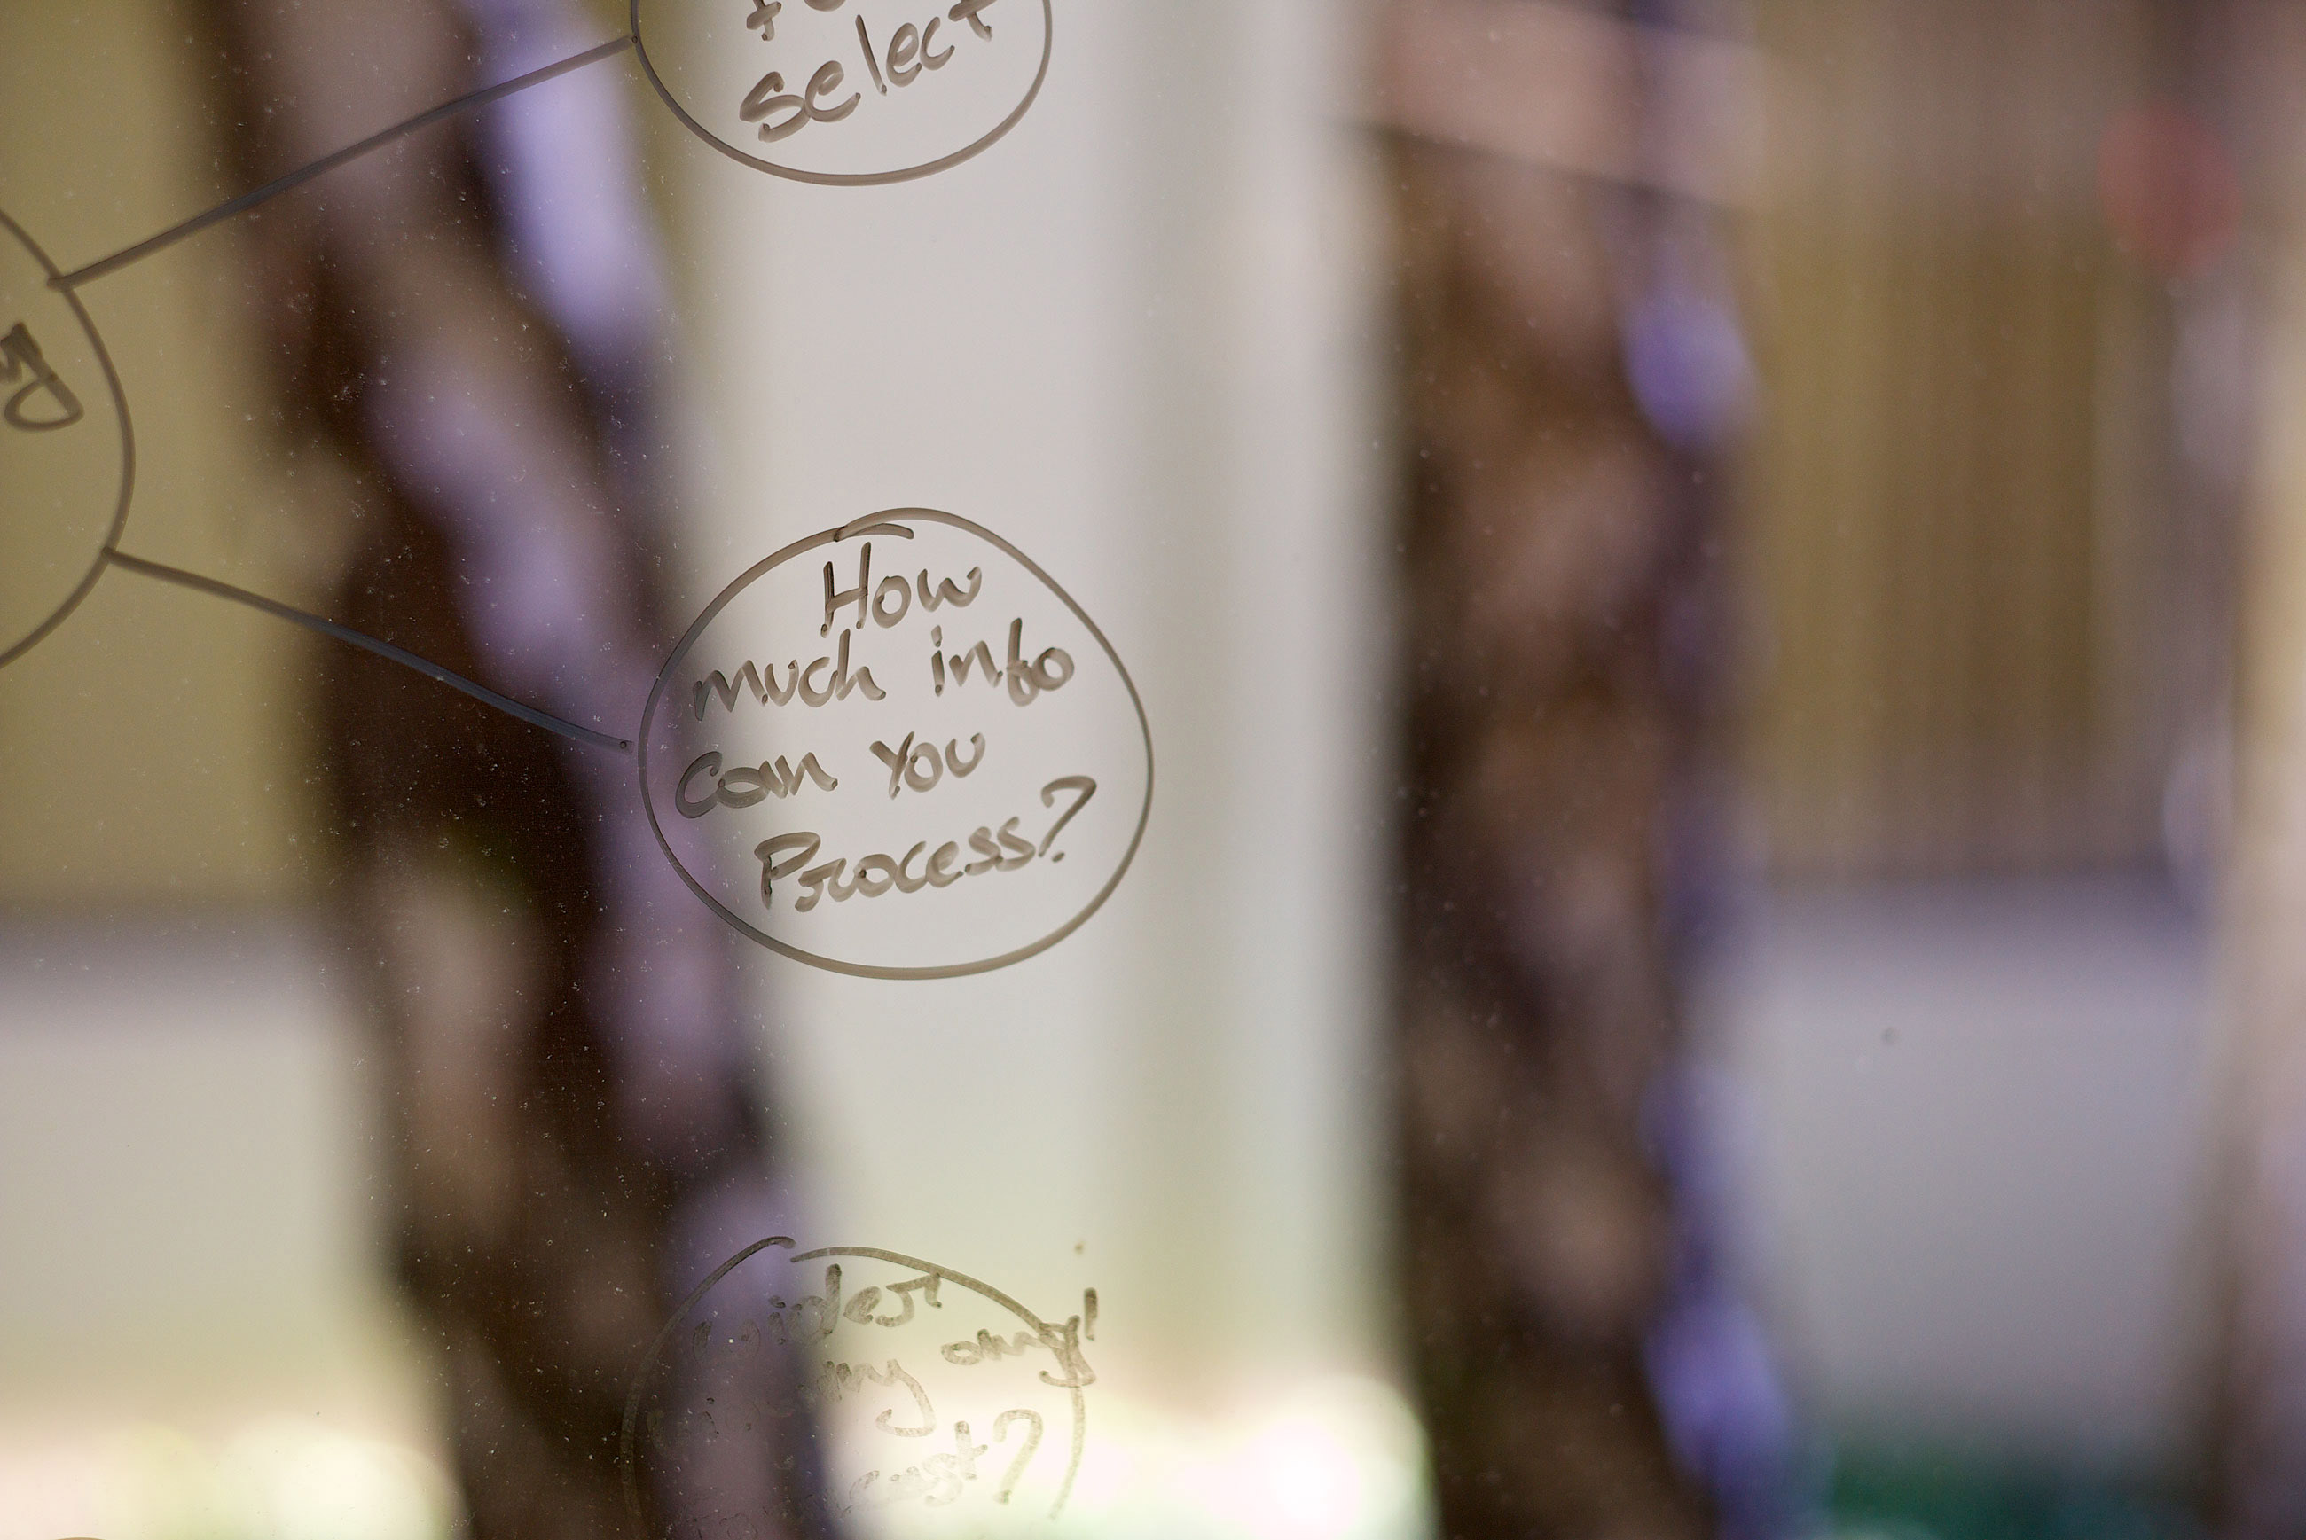
Questions

